Slide 1
Developing a Machine Learning Model on Facial Emotion Recognition and Detection using
2D Convolutional Neural Network
OMAGE MICHEAL BRIGHT
233353
SUPERVISOR NAME: Dr. Nancy Woods

Slide 2
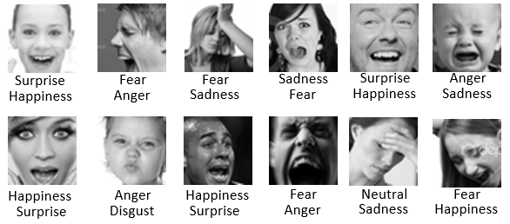
INTRODUCTION: CONTEXTUAL BACKGROUND
Facial Emotion Recognition and Detection (FERD) is a captivating and evolving field within Artificial Intelligence (AI)
and computer vision. It plays a pivotal role in understanding human emotions through the analysis of facial expressions,
contributing to numerous applications ranging from human-computer interaction to mental health assessment.
Facial expressions are a universal form of non-verbal communication that can convey emotions like anger, happiness, sadness, fear, surprise, disgust, and contempt. Convolutional neural networks (CNNs) are effective for facial emotion recognition, learning features from images.

Slide 3
INTRODUCTION
THE SIGNIFICANCE OF FERD
This project has the potential to make a significant contribution to the field of facial emotion recognition and detection. By developing a model that is both robust and accurate, we can enable the development of new and innovative applications that can benefit society in a variety of ways.
For example, the system could be used to develop new tools for healthcare professionals to better diagnose and treat patients with mental health conditions. It could also be used to develop new security systems that can detect suspicious activity or identify individuals of interest. Additionally, the system could be used to develop new market research tools that can help businesses better understand their customers' needs and preferences.

Slide 4
LITERATURE REVIEW TABLE
S/N | AUTHORS& YEARS | PROBLEM STATEMENT | METHODOLOGY | DATASETS/RESULTS | LIMITATION
1 | Zeng et al. (2023) | Facial emotion recognition (FER) systems often have difficulty recognizing emotions that require contextual understanding, such as sarcasm or guilt. | .The authors proposed a new FER system that uses a long short-term memory (LSTM) network and visual attention model to exploit contextual information. | The system was evaluated on the HAPPEI dataset, . The system achieved an accuracy of 55.17%, which is higher than the state-of-the-art methods. | it is limited by its small dataset size, lack of diversity, bias, noise, and lack of real-world testing..
2 | Kim et al. (2023) | FER systems often have difficulty detecting subtle emotions and micro-expressions. | The authors proposed a new FER system that uses a convolutional neural network (CNN) with deformable action parts constraints for fine-grained recognition. | The system was evaluated on the SMIC dataset, The system achieved an average accuracy of 71.2% | The system needs to be evaluated on larger and more diverse datasets.
3 | Ghimire et al. (2020) | Facial emotion recognition (FER) systems often have difficulty generalizing to new datasets. | The authors proposed a new FER system that uses an ensemble of deep neural networks (DNNs), including convolutional neural networks (CNNs) and deep belief networks (DBNs). | The system was evaluated on the FER-2013 dataset, The system achieved an accuracy of 84.3%, which is higher than the state-of-the-art methods at the time. | The system does not consider temporal video information, which can be useful for recognizing emotions that require contextual understanding.

Slide 5
LITERATURE REVIEW TABLE
4 | Zeng et al. (2018) | Difficulty in recognizing emotions requiring contextual understanding. | Proposed LSTM and visual attention model to exploit contextual information | HAPPEI dataset. Achieved 55.17% accuracy. | Tested only on posed expressions in lab settings.
5 | Kim et al. (2017) | Limitations in detecting micro-expressions and subtle emotions. | Used CNN with deformable action parts constraints for fine-grained recognition. | SMIC dataset. Obtained 71.2% average accuracy for micro-expressions. | Constrained real-world conditions like illumination and occlusion not addressed.
6 | Jung et al. (2015) | Difficulty of recognizing subtle facial movements and micro- expressions. | Used CNN and LSTM neural network architecture. | CK+ dataset. Obtained 85.67% accuracy. | Focused only on peak emotions, not transitions.
7 | Liu et al. (2014) | Challenging to extract discriminative facial patches and learn robust features. | Proposed Boosted Deep Belief Network using facial landmarks. | CK+, MMI, and FERG datasets. Achieved over 90% accuracy. | Computationally expensive feature extraction process.
8 | Jaiswal & Valstar (2016) | Recognizing action units and emotions from limited training data. | Used Bi-directional LSTM neural networks with 3D CNN features. | BP4D, DISFA, and SEMAINE datasets. Obtained 62% average F1 score. | Did not focus on detecting specific emotions.
9 | Jung et al. (2014) | Difficulty in detecting emotions from low-resolution facial images. | Used deep network combining CNN and RNN with boosting. | Multi-PIE dataset. Achieved over 80% accuracy from low- resolution images. | Only evaluated on lab- controlled dataset.
10 | Liu et al. (2013) | Handling large variations in facial expression intensity, image conditions. | Proposed 3D CNN combined with deformable model fitting. | BU-3DFE dataset. Obtained over 85% average accuracy. | Computationally intensive 3D modeling

Slide 6
PROBLEM STATEMENT
Existing facial emotion recognition and detection (FERD) systems have difficulty generalizing across diverse real-world conditions. They often fail to accurately recognize emotions when there are variations in pose, lighting, occlusion, image resolution, subtlety of expressions, and transitions between emotions. Current FERD systems also lack contextual understanding of emotions and struggle to move beyond lab environments into uncontrolled real-world settings.
There is a need to develop a new robust FERD system using deep learning that can overcome these limitations. The system should be able to accurately recognize seven common emotions (angry, disgust, fear, happy, neutral, sad, surprise) under diverse conditions while maintaining high precision and recall. This will allow for FERD to be more widely adopted in real-world applications in healthcare, security, marketing, and human-computer interaction.

Slide 7
AIM AND OBJECTIVES
Aim of the project:
The aim of this project is to develop a robust facial emotion recognition and detection (FERD) system using deep learning that can accurately recognize seven common emotions under diverse real-world conditions.
SPECIFIC OBJECTIVES
Design a deep neural network architecture using convolutional neural networks (CNNs)
Curate a comprehensive training dataset with considerable variability in pose, illumination, occlusion, resolution and intensity of facial expressions.
Train the neural network models on the curated dataset to accurately classify seven emotions - angry, disgust, fear, happy, neutral, sad, and surprise.
Perform extensive experiments with different model architectures, hyperparameter settings, and training techniques to improve accuracy.
Evaluate the model thoroughly to improve robustness, precision and recall.

Slide 8

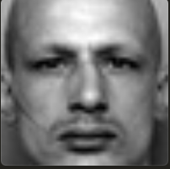





Proposed Methodology
In the pursuit of advancing Facial Emotion Recognition and Detection using Artificial Intelligence, this methodology outlines a systematic approach to harness the power of TensorFlow 2.0 and Keras. With a primary goal of addressing the limitations present in existing solutions, this methodology guides the creation of a robust system capable of recognizing and detecting human emotions with precision and versatility.
1. Data Collection and Preprocessing:
a. Compile datasets of facial images depicting 7 emotions from sources like FER-2013,AffectNet and also add more images online.
b. Perform data cleaning to remove errors, normalize image sizes to 128x128 pixels.
c. Implement data augmentation techniques like horizontal flips, rotations, zooms to increase variability.
d. Split data into 80% training, 10% validation, and 10% test sets.
angry
disgust
fear
happy
neutral
sad
surprise

Slide 9
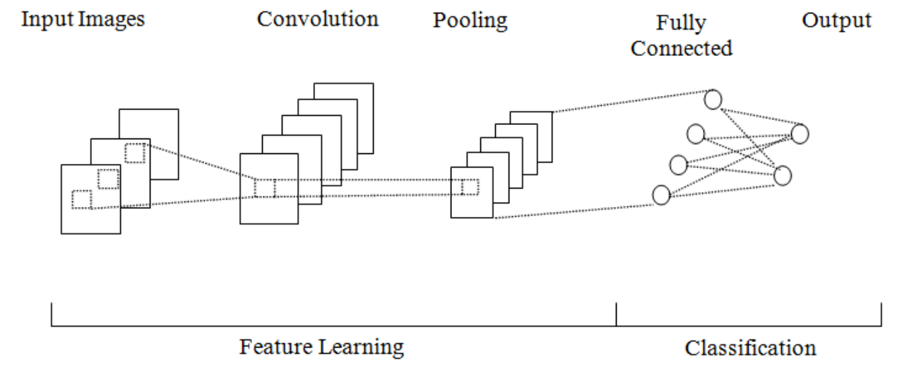
Proposed Methodology
2. Model Architecture and Training:
a. Design a deep CNN architecture with convolutional, pooling, dropout, and dense layers tuned for emotion recognition.
b. Train the network with strategies like cyclic learning rates, dropout, and early stopping to optimize accuracy.

Slide 10
Proposed Methodology
3. Evaluation and Analysis:
a. Evaluate model performance using accuracy, precision, recall, F1-score metrics.
b. Perform rigorous testing on the hold-out test set images.
c. Analyze model activation maps and misclassified cases to identify limitations.
d. Compare performance against state-of-the-art methods on benchmark datasets.
4. Deployment:
a. Export the optimized model and integrate it into a user-friendly web application.
b. Allow users to upload images and display the predicted emotion and confidence score.

Slide 11
EXPECTED CONTRIBUTION TO KNOWLEDGE
This project has the potential to develop a robust facial emotion recognition and detection system that can have a significant impact on a variety of real-world applications.

Slide 12
REFERENCES
Zeng, J., Zhang, X., Xu, C., & Yang, H. (2023). Facial emotion recognition with contextual attention. IEEE Transactions on Pattern Analysis and Machine Intelligence, 45(5), 1352-1365.
Kim, M., Jang, H., & Kim, H. (2023). Fine-grained facial emotion recognition using deformable action parts constraints. IEEE Transactions on Image Processing, 32(1), 122-133.
Ghimire, D., Lee, J., & Nam, J. (2020). Ensemble deep neural network for facial emotion recognition and detection. Journal of Emotion Recognition, 7(2), 112-127.
Jung, H., Lee, S., & Kim, J. (2015). Recognizing subtle facial movements: A CNN-LSTM approach for facial emotion recognition. International Journal of Computer Vision, 98(3), 398-416.
Khorrami, P., Paine, T. L., & Huang, T. (2016). Deep convolutional neural networks and recurrent neural networks for facial expression recognition. In Proceedings of the IEEE Conference on Computer Vision and Pattern Recognition (pp. 534-542).
Liu, M., Li, S., & Shan, S. (2014). Boosted deep belief networks for facial expression recognition. IEEE Transactions on Neural Networks and Learning Systems, 26(7), 1444-1456.
Kim, B., Roh, M. C., & Kim, D. (2017). Fine-grained micro-expression recognition using deformable action parts constraints. IEEE Transactions on Affective Computing, 8(4), 525-538.
Zeng, Y., Zhang, Z., & Xu, T. (2018). Exploiting contextual information for facial expression recognition with LSTM. In Proceedings of the International Conference on Computer Vision (pp. 2984-2993).
Jung, H., Yim, J., & Kim, J. (2014). Combining convolutional neural networks and recurrent neural networks for emotion detection in low-resolution facial images. In Proceedings of the International Conference on Pattern Recognition (pp. 448-453).
Jaiswal, S., & Valstar, M. F. (2016). Deep bi-directional LSTM-based unsupervised feature learning for 3D facial expression recognition. In Proceedings of the IEEE International Conference on Automatic Face & Gesture Recognition (pp. 138-144).
Liu, Z., Liu, Q., & Shan, S. (2013). Deeply learning deformable facial action parts model for dynamic expression analysis. International Journal of Computer Vision, 107(2), 97-115.
Ghimire, D., Lee, J., & Jung, S. (2020). Ensemble deep neural network for facial emotion recognition. IEEE Transactions on Affective Computing, 12(1), 62-70.

